Slide 1
Using Declarative Jenkins Pipelines
COURSE OVERVIEW

Slide 2



Repo URL Credentials
Source Code
Poll SCM CRON
Triggers
Build Environment
Secrets Certificates
Build Test
Build
Post- build
Publish/deploy Notify
config.xml

Slide 3
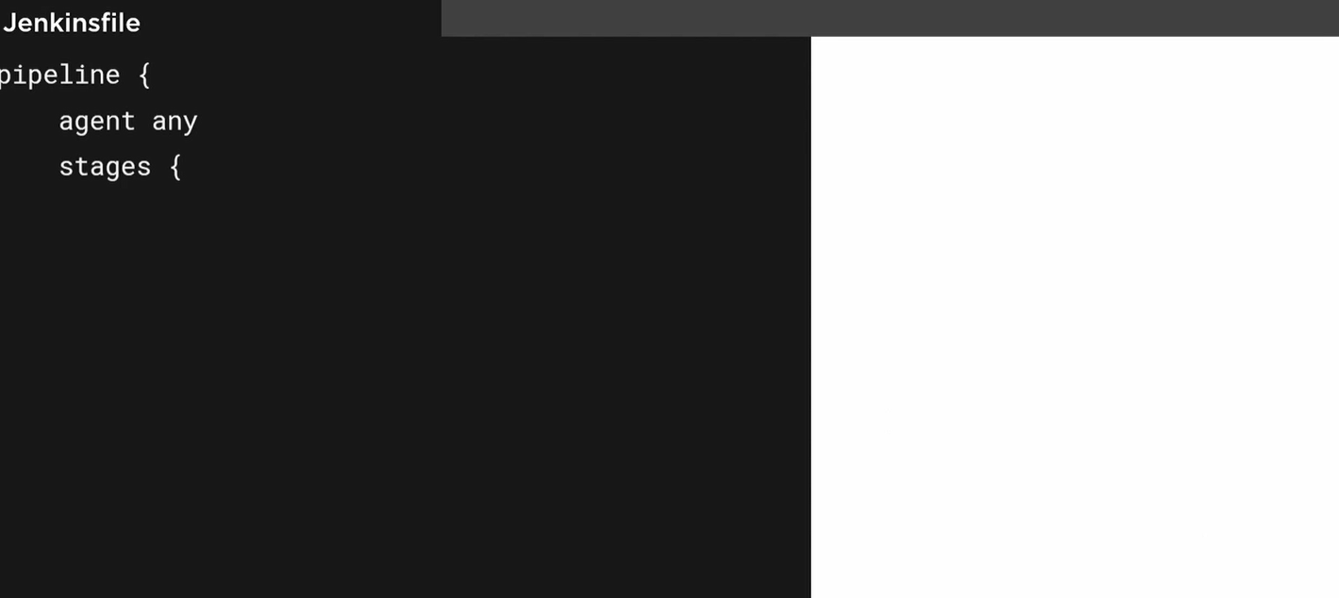

Slide 4
